Slide 1
Structure Optimization of E-Commerce Platform Based on Blockchain Technology
TEAM MEMBERS: [A14 BATCH]
1. Aruna M
2. Harini T M
3. Krithikaa K
GUIDE: Mrs.C.Vijayalakshmi

Slide 2
INTRODUCTION
E-Commerce has become more and more popular because of rich products, fast transactions, and free from time, locations, stores, and so on. However, the disclosure of personal data such as their IDs, addresses, and phone numbers has become a major concern for online activities. The current e-commerce model is at the crossroads of ownership and privacy. To address this, this article creates an enterprise protocol that uses smart personal contracts to protect privacy during the negotiation phase. This protocol allows contracting parties to conduct business without disclosing personal information such as identity, address, and phone number. Furthermore, we employ the zero-knowledge proof to ensure ownership.

Slide 3
LITERATURE SURVEY
S.NO | TITLE | YEAR | AUTHOR | INFERENCE | DRAWBACK
1 | A Reputation based Trust Model for Peer-to-Peer E-commerce communities | International Conference on. IEEE, 2003, pp. 275–284. | L. Xiong and L. Liu | The peer-to-peer e-commerce community is often viewed as an environment that offers both opportunities and threats. One way to minimize the risks in such an open community is to use community reputation to gauge credibility and predict future peer behavior. This paper presents PeerTrust a consistent adaptive trust model for quantifying and comparing the reliability of partners based on a transaction-based feedback system. The article discusses two main features of the model. First, they introduce three basic trust parameters in calculating the reliability of partners. In addition to the feedback you receive from transactions with other partners, record all transactions made by the feedback source on the creditworthiness assessment form | Community based feedbacks are often simple aggregations of positive and negative feedbacks that peers have received for transactions they have performed and cannot accurately capture the trustworthiness of peers

Slide 4
S.NO | TITLE | YEAR | AUTHOR | INFERENCE | DRAWBACK
2 | Challenges and Opportunities associated with Bitcoin-Based Transaction rating system | International Conference on Financial Cryptography and Data Security. Springer, 2014, pp. 33–42. | D. Vandervort | Seller rankings from previous buyers are presented to provide information to help new customers make purchasing decisions. However, the purpose of Bitcoin is to hide the buyer-seller relationship at a level of anonymity and prevent buyers from finding or verifying this information. The bitcoin community appreciates this level of anonymity and continues to embrace bitcoin, but buyers and sellers who want to know more about their trading partners want to be known for their strength. Allows for greater transparency. They consider three models by which credit/rating systems can be applied to Bitcoin transactions, and their associated pros and cons. We believe there are technological and social challenges that we all face. | The drawback is that Bitcoin stands for the anonymity of the Bitcoin community, and is often referred to as a pseudonym because it is not an absolute asset and is not a way to avoid cumbersome surveillance systems. It is also a hedge against personal user profiles/data mining for large companies like K-Mart.

Slide 5
S.NO | TITLE | YEAR | AUTHOR | INFERENCE | DRAWBACK
3 | Zerocash: Decentralized Anonymous Payments from Bitcoin | Symposium on. IEEE, 2014, pp. 459–474. | Eli Ben- Sasson, Alessandro Chiesa, Christina Garman , Matthew Green, Ian Miers , Eran Tromer, Madars Virza. | In this paper, they construct a full-fledged ledger-based digital currency with strong privacy guarantees. Our results leverage recent advances in zero-knowledge Succinct Non-interactive ARguments of Knowledge (zk-SNARKs). First, we formulate and construct decentralized anonymous payment schemes (DAP schemes). A DAP scheme enables users to directly pay each other privately: the corresponding transaction hides the payment’s origin, destination, and transferred amount. We provide formal definitions and proofs of the construction’s security. Second, build Zerocash, a practical instantiation of our DAP scheme construction. In Zerocash, transactions are less than 1 kB and take under 6 ms to verify — orders of magnitude more efficient than the less-anonymous Zerocoin and competitive with plain Bitcoin | Typical legitimate users wish to keep their spending habits private from their peers, are risk-averse and do not wish to expend continual effort in protecting their privacy, and are often not sufficiently aware of their compromised privacy

Slide 6
S.NO | TITLE | YEAR | AUTHOR | INFERENCE | DRAWBACK
4 | The study of E-Commerce Security Issues and Solutions | International Journal of Advanced Research in Computer and Communication Engineering, vol. 2, no. 7, 2013. | Niranjanamurthy M, DR. Dharmendra Chahar | Dimensions of E-commerce security-Integrity, Non-repudiation, Authenticity, Confidentiality, Privacy, Availability. E-Commerce offers the banking industry great opportunity, but also creates a set of new risks and vulnerability such as security threats. Information security, therefore, is an essential management and technical requirement for any efficient and effective Payment transaction activities over the internet. Still, its definition is a complex Endeavour due to the constant technological and business change and requires a co-ordinated match of algorithm and technical solutions. In this paper we infer Overview of E-commerce security, Understand the Online Shopping Steps to place an order, Purpose of Security in E-commerce, Different security issues in E-commerce, Secure online shopping guidelines. | Due to the increase in warnings by the media from security and privacy breaches like identity theft and financial fraud, and the elevated awareness of online customers about the threats of performing transactions online, e-commerce has not been able to achieve its full potential.

Slide 7
S.NO | TITLE | YEAR | AUTHOR | INFERENCE | DRAWBACK
5 | The Effect of Online Privacy Information on Purchasing Behavior: An Experimental Study | Information Systems Research,Vol.22,No.2,June 2011. | Janice Y. Tsai, Serge Egelman, Lorrie Cranor and Alessandro Acquisti | Although online retailers detail their privacy practices in online privacy policies, this information often remains invisible to consumers, who seldom make the effort to read and understand those policies. This paper reports on research undertaken to determine whether a more prominent display of privacy information will cause consumers to incorporate privacy considerations into their online purchasing decisions.designed an experiment in which a shopping search engine interface clearly and compactly displays privacy policy information. When such information is made available, consumers tend to purchase from online retailers who better protect their privacy. This study indicates that when privacy information is made more salient and accessible, some consumers are willing to pay a premium to purchase from privacy protective websites. This result suggests that businesses may be able to leverage privacy protection | After the purchase, the consumer may not know how the merchant will use the personal information she revealed as part of the transaction (Acquisti and Grossklags 2005b). This lack of information arguably affects individual behavior in different ways.

Slide 8
PROBLEM STATEMENT
E-Commerce has grown in popularity as a result of the wide range of products available, the speed with which transactions can be completed, and the lack of time, location, and store constraints. However, internet activities have made the revelation of personal data such as IDs, addresses, and phone numbers a big problem. In fact, it has created a huge "gray industry" that seriously threatens user security and privacy.

Slide 9
TECHNOLOGY STACK
Software:
Backend Language: Python
Technology: Blockchain
Platform(IDE): Anaconda
Database Tool: SQLyog
Operating System: Windows 10
Hardware:
Memory of 2 GB RAM.
64 bit distribution capable of running 32 bit application.
1200*800 minimum screen resolution
2 GB of available disk space minimum 4 GB recommended.

Slide 10
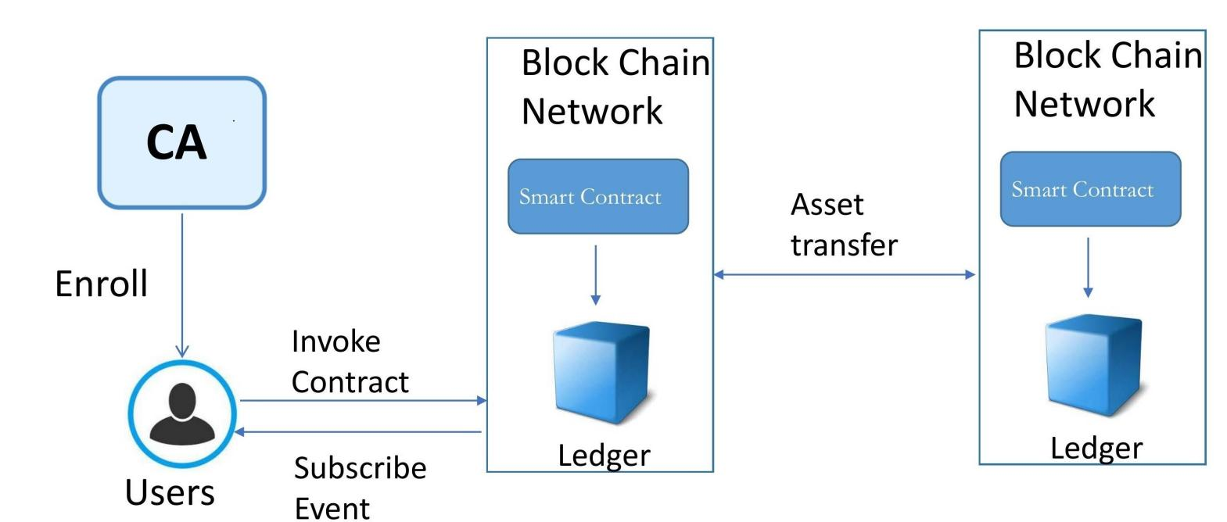
SYSTEM ARCHITECTURE

Slide 11
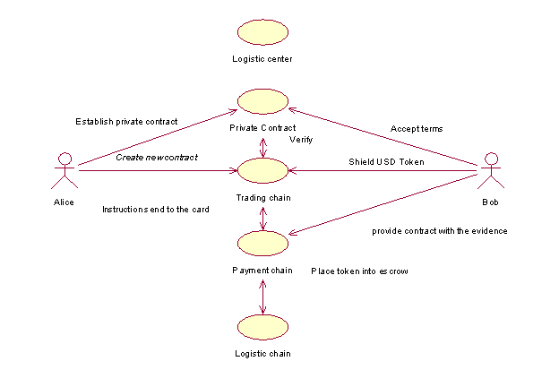
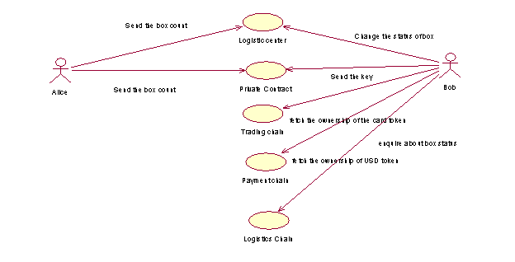
SYSTEM DESIGN – USE CASE DIAGRAM
Negotiation Phase
Delivery Phase

Slide 12
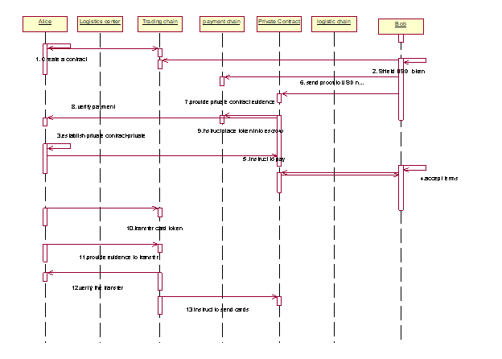
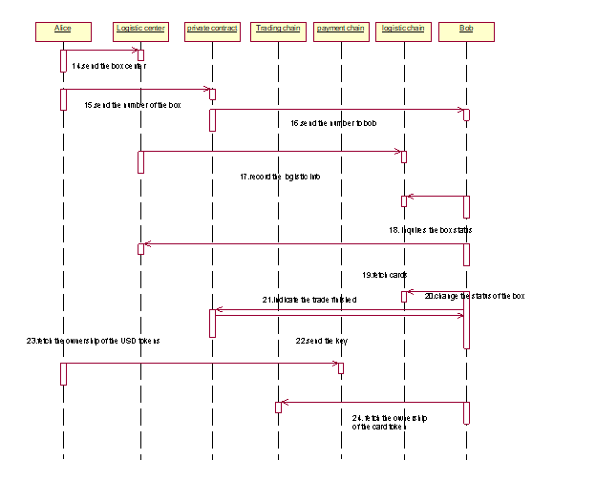
SYSTEM DESIGN – SEQUENCE DIAGRAM
Negotiation Phase
Delivery Phase

Slide 13
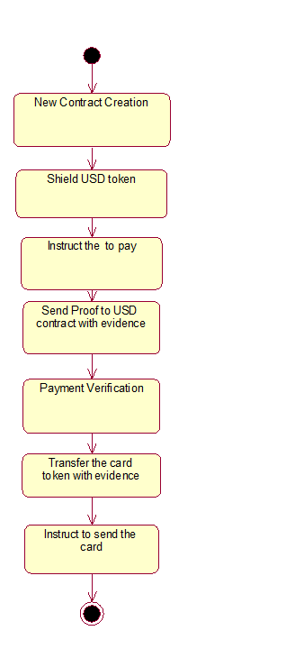
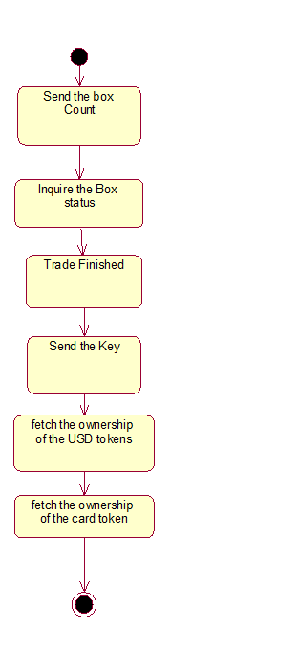
SYSTEM DESIGN – ACTIVITY DIAGRAM
Negotiation Phase
Delivery Phase

Slide 14
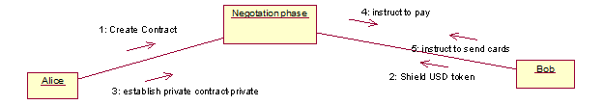
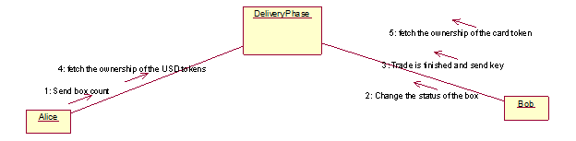
SYSTEM DESIGN – COLLABORATION DIAGRAM
Negotiation Phase
Delivery Phase

Slide 15
SYSTEM DESIGN – DB DESIGN PRIVACY COMMERCE DB - PRODUCT TABLE
Field Name | Data Type | Length | Description | Constraints
id | int | 99 | Id for each product | Primary Key
sid | Varchar | 9999 | Sender address | Null
pkey | Varchar | 9999 | public key for the product | Null
product | Varchar | 9999 | Name of the product | Null
quantity | Varchar | 88 | Quantity of the product | Null
amount | Varchar | 88 | Amount of the product | Null
token | Varchar | 9999 | Unique token for every product | Null

Slide 16
REGISTER TABLE
Field Name | Data Type | Length | Description | Constraints
id | Number | 66 | Id for each buyer who register to buy the product | Primary Key
name | Varchar | 777 | Name of the buyer | Null
mno | Varchar | 777 | Mobile number for the buyer | Null
address | Varchar | 777 | Address of the buyer for delivery purpose | Null
master | Varchar | 9999 | public key | NUll
private | varchar | 9999 | private key | Null

Slide 17
SMART CONTRACT TABLE
Field Name | Data Type | Length | Description | Constraints
id | int | 88 | Id for each contract | Primary Key
sid | Varchar | 7777 | Id for each Sender address | Null
key1 | varchar | 7777 | Sender private key | Null
rid | Varchar | 7777 | Recipient address | Null
pid | Varchar | 6666 | Product ID | Null
status | Varchar | 6666 | Delivery status of the product | Null

Slide 18
TRANS TABLE
Field Name | Data Type | Length | Description | Constraints
id | int | 90 | Id for each transaction | Primary Key
sid | Varchar | 9090 | Sender address | Null
rid | Varchar | 9090 | Recipient address | Null
pid | Varchar | 9090 | ID for each product | Null

Slide 19
USD TOKEN TABLE
Field Name | Data Type | Length | Description | Constraints
id | int | 66 | Id for each token | Primary Key
sid | Varchar | 7777 | Id for all the Sender address | Null
pkey | Varchar | 7777 | Public key for all the product | Null
amount | Varchar | 7777 | Amount of the product | Null
token | Varchar | 7777 | Token for all the product | Null

Slide 20
MODULES
The entire project mainly consists of 4 modules, which are
Central Authority
Token Creation
Negotiation phase
Delivery phase
CENTRAL AUTHORITY
The CA component is in charge of issuing PKI-based certificates to organization members and their users. A root certificate (rootCert) is issued to each member and one enrollment certificate (ECert) to each authorized user. The Client interacts with the blockchain network and smart contracts. It has to obtain a valid identity certificate from CA before joining the application channel/chains in the network. Both users and intelligent logistics centers act as clients.

Slide 21
TOKEN CREATION
Thus, Alice has to create a note-contract for the set of collector cards and issue a shielded token for herself . Now Alice owns a CARD token. At a same time, Bob shields some USD tokens by the USD note- contract.
NEGOTIATION PHASE
Alice establishes a private contract with Bob in a private channel . The private contract specifies the trade of the cards at a specific price in USD between Alice and Bob. The private contract also refers to the cards and USD note- contracts. Besides, the private contract also receives the rel- evant public keys and payment addresses of the two parties (including the Hash of physical addresses). When Alice initializes the contract, Bob can send to the private contract a transaction indicating acceptance of the terms We assume that the USD must be paid first. After the private contract receives the confirmation transaction, the private contract issues an instruction to Bob to pay the relevant amount of USD to Alice (Bob places the USD tokens into the escrow.USD tokens to a mediator’s payment address by generating the necessary zk-SNARK proof and sends it to the USD note-contract(Miner).

Slide 22
DELIVERY PHASE
Alice places the cards into a delivery box which has a unique number.Then Alice sends the delivery box to the intelligent logistics center (suppose the intelligent center is reliable). Transport companies are responsible for inspecting and monitoring the legitimacy of the items. Alice’s client sends the Hash of Bob’s address to this box and sends the number of the box to the private contract. The private contract then sends the number of the delivery box to Bob’s client.

Slide 23
TESTING AND PERFORMANCE ANALYSIS UNIT TESTING:
UNIT TESTING is a type of software testing where individual units or components of a software are tested. In this project, each input is denoted with specify constraint and the violation of these constraint will display error message. Thus it verify the unit testing.
Result: All the test cases mentioned above passed successfully. No defects encountered

Slide 24
SELLER AND BUYER - REGISTRATION VALIDATION PAGE
s.no | ACTION | INPUT | EXPECTED OUTPUT | ACTUAL OUTPUT | TEST RESULT
1. | Enter the name, mobile number and address as seller’s details | Name: Alice Mobile number: 9876543210 Address: Chennai | Successfully created pop up message | Successfully created pop up message | Passed.
2. | Enter the name, mobile number and address as buyer’s details | Name: Bob Mobile number: 6549873012 Address: Bangalore | Successfully created pop up message | Successfully created pop up message | Passed.

Slide 25
SELLER AND BUYER - HASH CODE GENERATION
s.no | ACTION | INPUT | EXPECTED OUTPUT | ACTUAL OUTPUT | TEST RESULT
1. | After entering seller’s details hashcode is produced | Name: Alice Mobile number: 9876543210 Address: Chennai | Hashcode is produced | Hashcode is produced | Passed.
2. | After entering buyer’s details hashcode is produced | Name: Bob Mobile number: 6549873012 Address: Bangalore | Hashcode is produced | Hashcode is produced | Passed

Slide 26
BUYER AND SELLER - VIEW TRANSACTION
s.no | ACTION | INPUT | EXPECTED OUTPUT | ACTUAL OUTPUT | TEST RESULT
1. | Buyer - The transaction that we performed during product buying can be viewed using transaction | Node URL: http://127.0.0.1:5000 | http://127.0.0.1:5000 URL’s transaction is displayed | http://127.0.0.1:5000 URL’s transaction is displayed | passed
2. | Seller - The transaction that we performed during product selling can be viewed using transaction | Node URL: http://127.0.0.1:5000 | http://127.0.0.1:5000 URL’s transaction is displayed | http://127.0.0.1:5000 URL’s transaction is displayed | passed

Slide 27
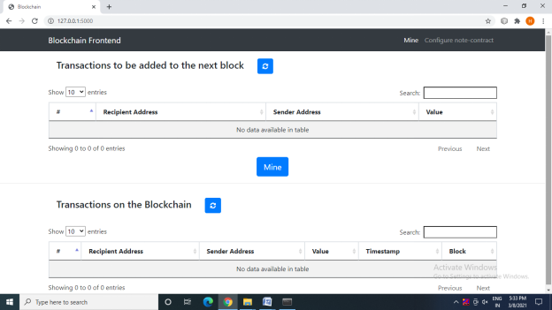
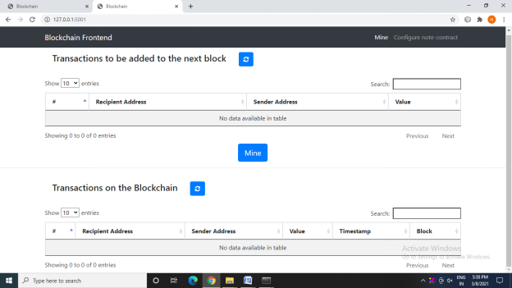
SCREENSHOTS

Slide 28
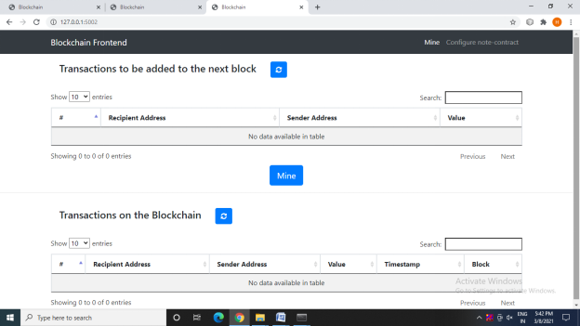
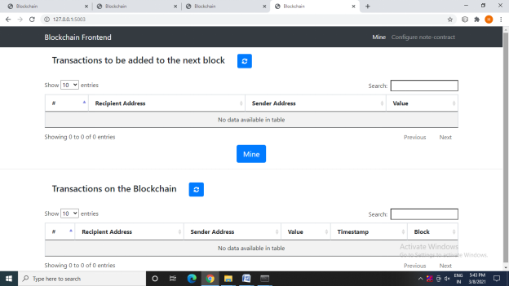

Slide 29
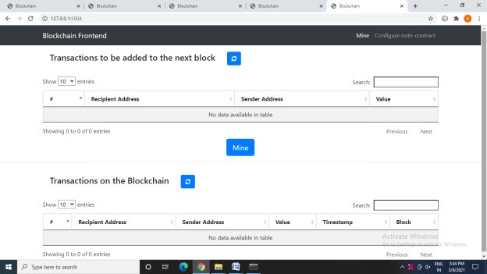
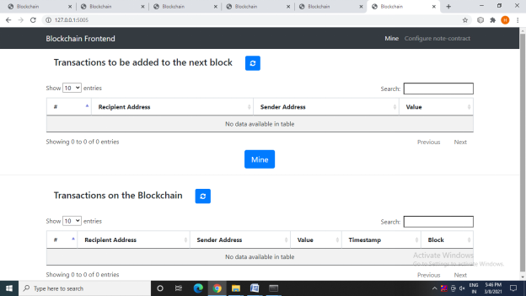

Slide 30
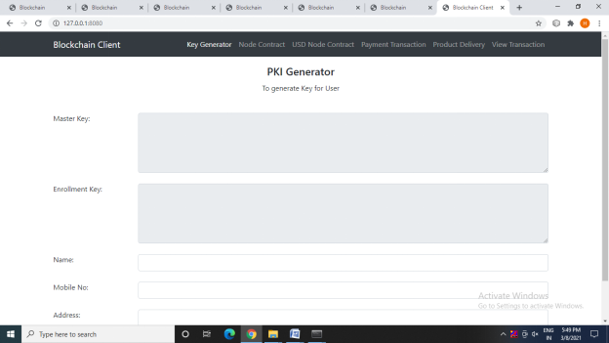
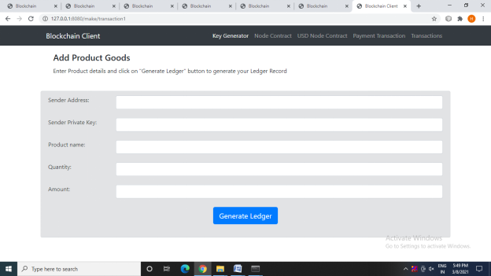

Slide 31
CONCLUSION AND FUTURE ENHANCEMENT
We design a privacy-preserving model for E-commerce systems based on the blockchain technology. In order to protect users’ identities and guarantee proof of ownership, we employ a zero-knowledge proof algorithm called zk-SNARKs. The algorithm allows one party (the prover) prove to another party (the veriﬁer) that a given statement is true, without conveying any information apart from the fact that the statement is indeed true by zero knowledge proof. To protect users’ addresses, we index the address by a hash string and record it on the logistics ledger. To protect phone numbers, we use delivery boxes and intelligent logistics centers that work with IoT. Different from common practice, buyers do not need to provide a phone number for SMS notiﬁcation.
Finally, We build implementations of the architecture using two existing blockchain application platforms. Performance analysis of the blockchain platforms provided insights into the models feasibility and further considerations for deploying a usable implementation. In the future, we will implement our logistics chain on blockchain platforms such as IOTA, which is mainly used in the ﬁeld of IoT, and perform further simulations on the hardware through the Raspberry Pi.

Slide 32
REFERENCES
[1] M. Niranjanamurthy and D. D. Chahar, “The study of e-commerce security issues and solutions,” International Journal of Advanced Research in Computer and Communication Engineering, vol. 2, no. 7, 2013.
[2] J. Y. Tsai, S. Egelman, L. Cranor, and A. Acquisti, “The effect of online privacy information on purchasing behavior: An experimental study,”Information Systems Research,Vol.22,No.2,June 2011.
[3] B. Berendt, O. G¨unther, and S. Spiekermann, “Privacy in e-commerce: stated preferences vs. actual behavior,” Communications of the ACM, vol. 48, no. 4, pp. 101–106, 2005.
[4] L. Xiong and L. Liu, “A reputation-based trust model for peer-to-peer e-commerce communities,” in E-Commerce, 2003. CEC 2003. IEEE International Conference on. IEEE, 2003, pp. 275–284.
[5] D. Vandervort, “Challenges and opportunities associated with a bitcoinbased transaction rating system,” in International Conference on Financial Cryptography and Data Security. Springer, 2014, pp. 33–42.
[6] Eli Ben-Sasson, Alessandro Chiesa, Christina Garman and Matthew Green “Zerocash: Decentralized anonymous payments from bitcoin,” in Security and Privacy (SP), 2014 IEEE Symposium on. IEEE, 2014, pp. 459–474.
[7] Rosario Gennaro, Steven Goldfeder and Arvind Narayanan “Threshold-optimal dsa/ecdsa signatures and an application to bitcoin wallet security,” in International Conference on Applied Cryptography and Network Security. Springer, 2016, pp. 156–174.

Slide 33
[8] D. Ron and A. Shamir, “Quantitative analysis of the full bitcoin transaction graph,” in International Conference on Financial Cryptography and Data Security. Springer, 2013, pp. 6–24.
[9] N. Hackius and M. Petersen, “Blockchain in logistics and supply chain: trick or treat?” A chapter in Digitalization in Supply Chain Management and Logistics: Smart and Digital Solutions for an Industry 4.0 Environment, 2017, pp 3-18 from Hamburg University of Technology (TUHH), Institute of Business Logistics and General Management.
[10] Hemantkumar P. Bulsara, Pratiksinh S. Vaghela."Blockchain Technology for E-commerce Industry" in International Journal of advanced Science and Technology,Vol.29,No.5,2020.
[11] Shazia Yasin,Khalid Haseeb,Rashid Jalal Qureshi,"Cryptography Based E-Commerce Security: A Review" in International Journal of Computer Science Issues,9(2),2012.
[12] Uriel Feige,Amos Fiat,Adi Shamir,"Zero-knowledge proofs of identity",in Journal of Cryptology,Springer,1,77-94(1988).
[13] Weiqin Zou,David Lo,Pavneet Singh Kochhar,Xuan-Bach D. Le,Xin Xia,Yang Feng,Zhenyu Chen,Baowen Xu, "Smart Contract Development: Challenges and Opportunities"published in IEEE Transactions on Software Engineering,24 September 2019.
[14] Paul J.Taylor,TooskaDargahi,AliDehghantanha,Reza M.Parizi,Kim-Kwang RaymondChood"A systematic literature review of blockchain cyber security" in Digital Communication and Networks,Volume 6, Issue 2, May 2020, Pages 147-156.

Slide 34
PUBLICATION DETAILS
Mrs.C.Vijayalakshmi, Aruna M, Harini T M, Krithikaa K “OPTIMIZATION OF E-COMMERCE PLATFORM BASED ON BLOCKCHAIN TECHNOLOGY”, International Journal for Research in Applied Science & Engineering Technology (IJRASET), ISSN:2321-9653, Volume.9, Issue VI, pp.1334-1347, June 2021
DOI Details: https://doi.org/10.22214/ijraset.2021.35262

